Slide 1
Java Workshop
Vasanth
Geeksgod

Slide 2
Introduction to Java
Java is an Object Oriented programming language
It was created in 1995.
It is owned by Oracle and more than 3 billion devices use Java

Slide 3
Why Java?
Java works on different platforms (Windows, Mac, Linux, etc.)
It is one of the most popular programming language in the world
It is easy to learn and simple to use
It is open-source and free
It is secure, fast and powerful
It has a huge community support (tens of millions of developers)
As Java is close to C++ and C#, it makes it easy for programmers to switch to Java or vice versa

Slide 4
Java Variables
Variables are containers for storing data values.
In Java, there are different types of variables, for example:
String - stores text, such as "Hello". String values are surrounded by double quotes
int - stores integers (whole numbers), without decimals, such as 123 or -123
float - stores floating point numbers, with decimals, such as 19.99 or -19.99
char - stores single characters, such as 'a' or 'B'. Char values are surrounded by single quotes
boolean - stores values with two states: true or false

Slide 5
Java Keywords
Java keywords are also known as reserved words. Keywords are particular words that act as a key to a code. These are predefined words by Java so they cannot be used as a variable or object name or class name.
There are around 48 keywords in Java
Example: the data types – int, long, double, etc.

Slide 6
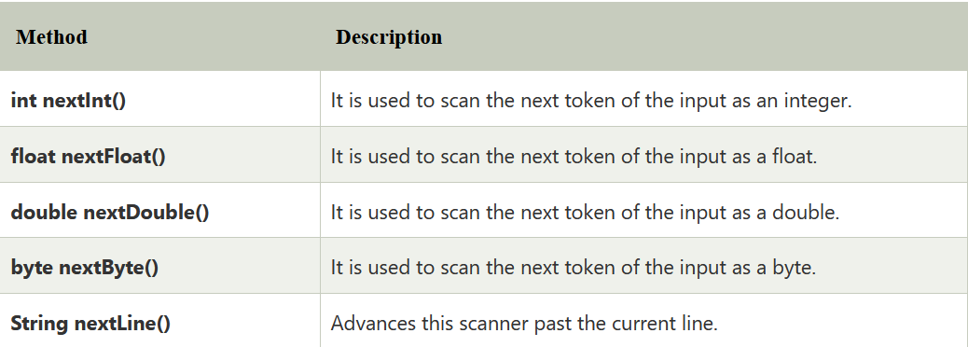
Getting Input from the user in Java
Java Scanner class allows the user to take input from the console. It belongs to java.util package. It is used to read the input of primitive types like int, double, long, short, float, and byte. It is the easiest way to read input in Java program.
Scanner sc=new Scanner(System.in);

Slide 7
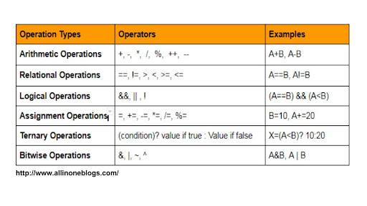
Operators in Java

Slide 8
Conditional statements in Java – If…else and switch…case
Java has the following conditional statements:
Use if to specify a block of code to be executed, if a specified condition is true
Use else to specify a block of code to be executed, if the same condition is false
Use else if to specify a new condition to test, if the first condition is false
Use switch to specify many alternative blocks of code to be executed

Slide 9
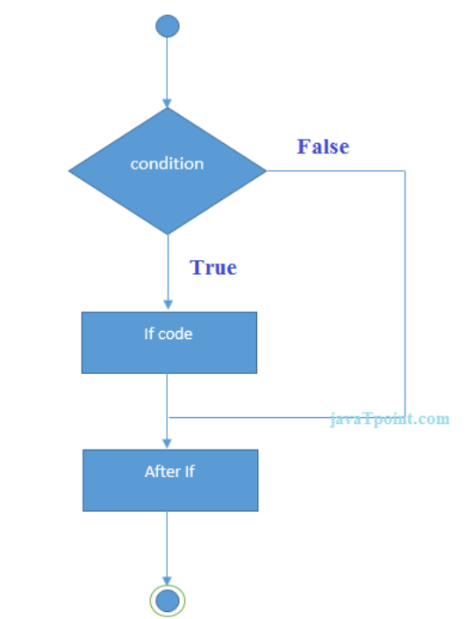
If condition

Slide 10
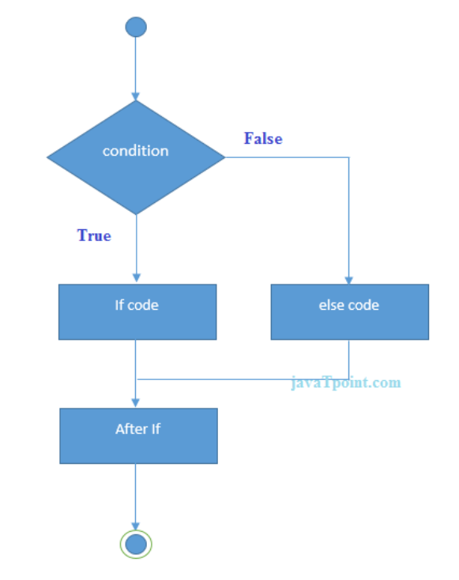
If else

Slide 11
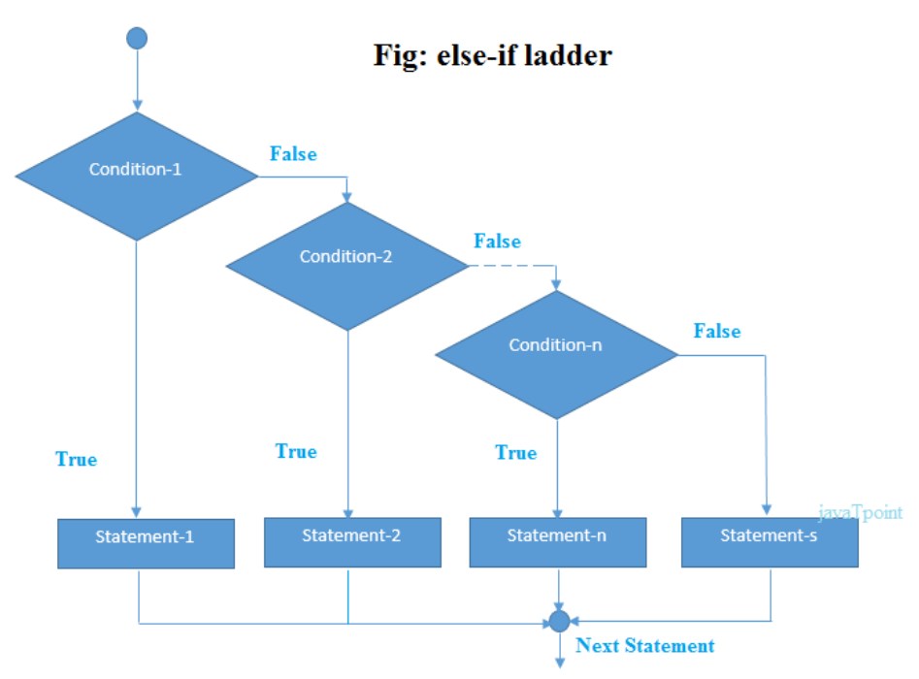
If-else-if

Slide 12
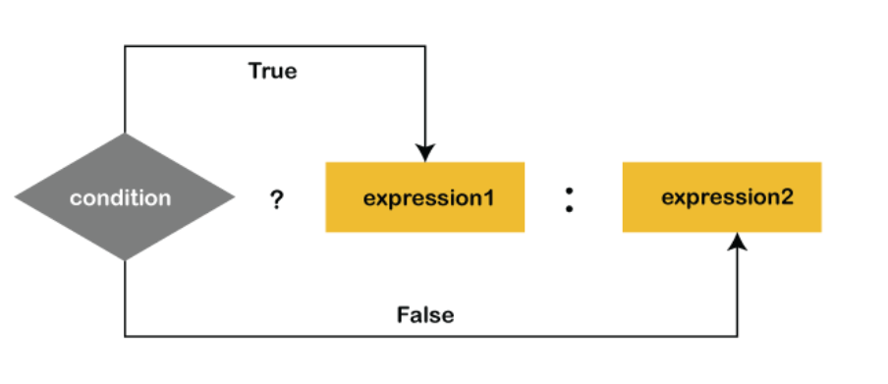
Ternary Operator
variable = (condition) ? expression1 : expression2

Slide 13
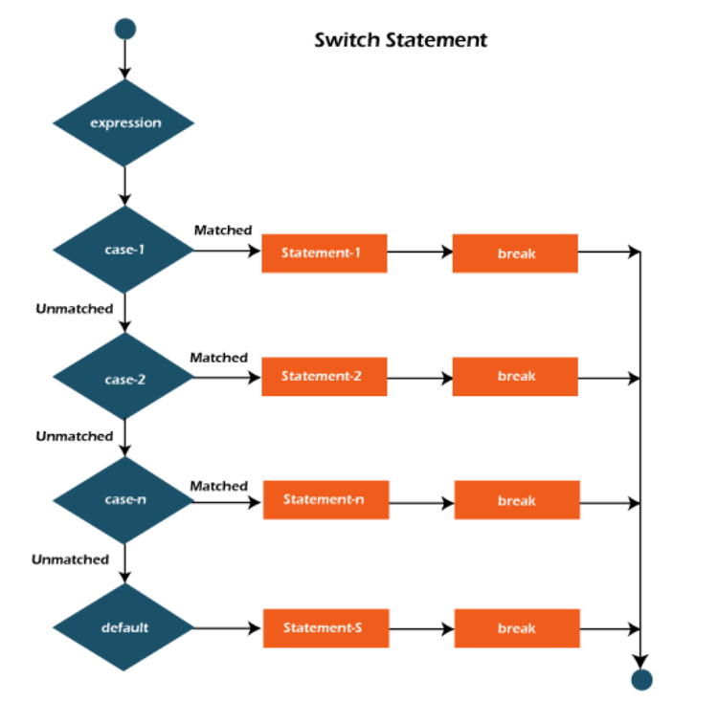
Switch Case

Slide 14
Loops in Java
Loops in programming languages is a feature which facilitates the execution of a set of instructions/functions repeatedly while some condition evaluates to true. Java provides three ways for executing the loops. While all the ways provide similar basic functionality, they differ in their syntax and condition checking time.
While loop
For loop
Do While loop

Slide 15
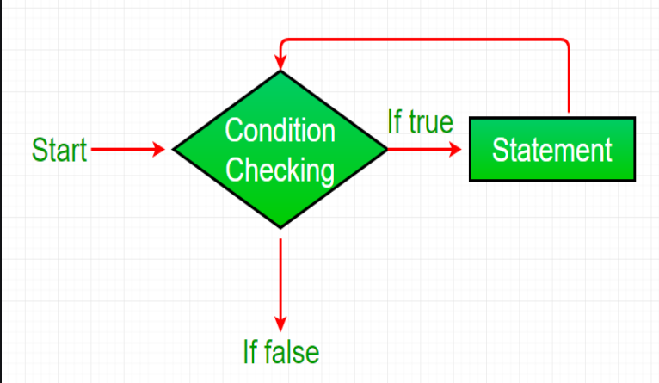
While loop

Slide 16
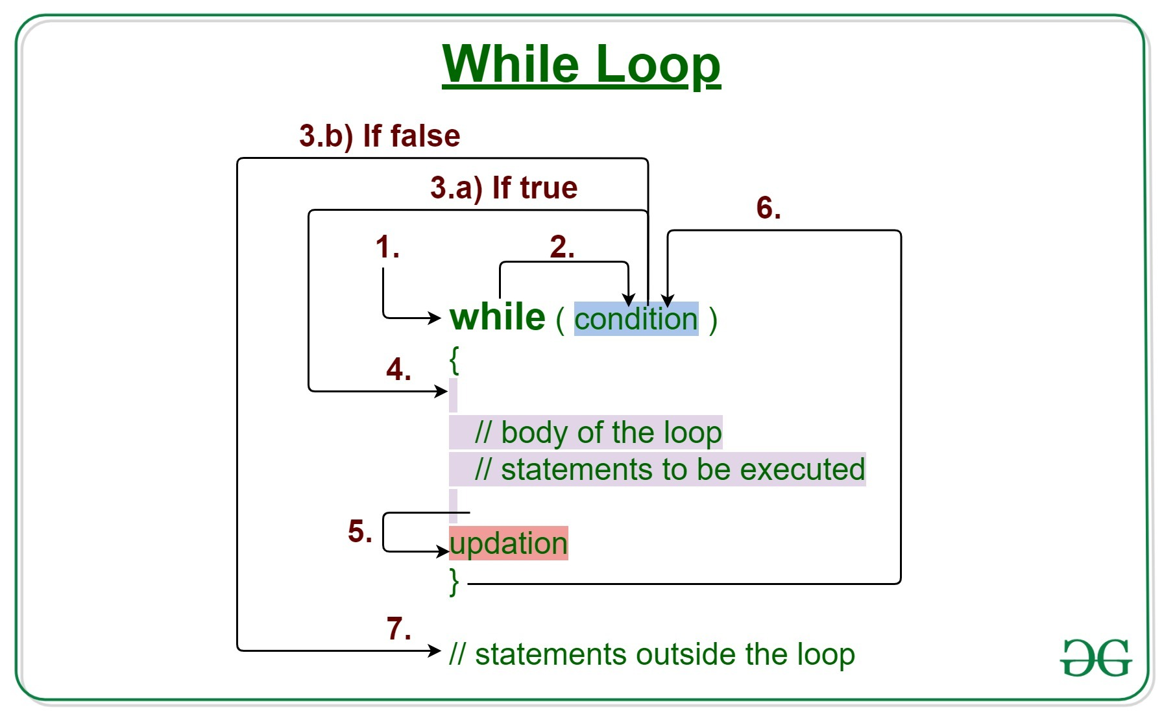
While loop

Slide 17
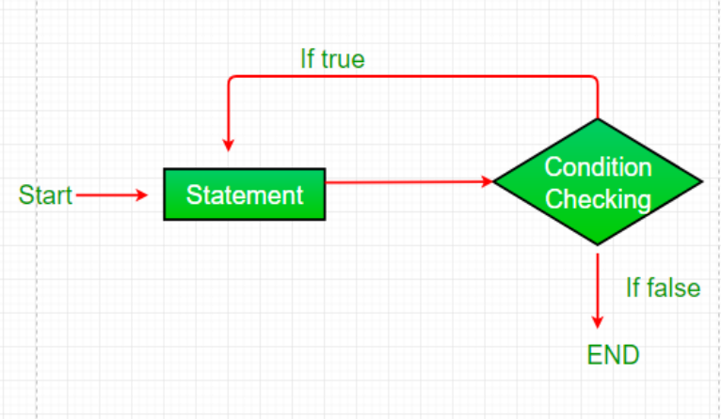
Do while loop

Slide 18
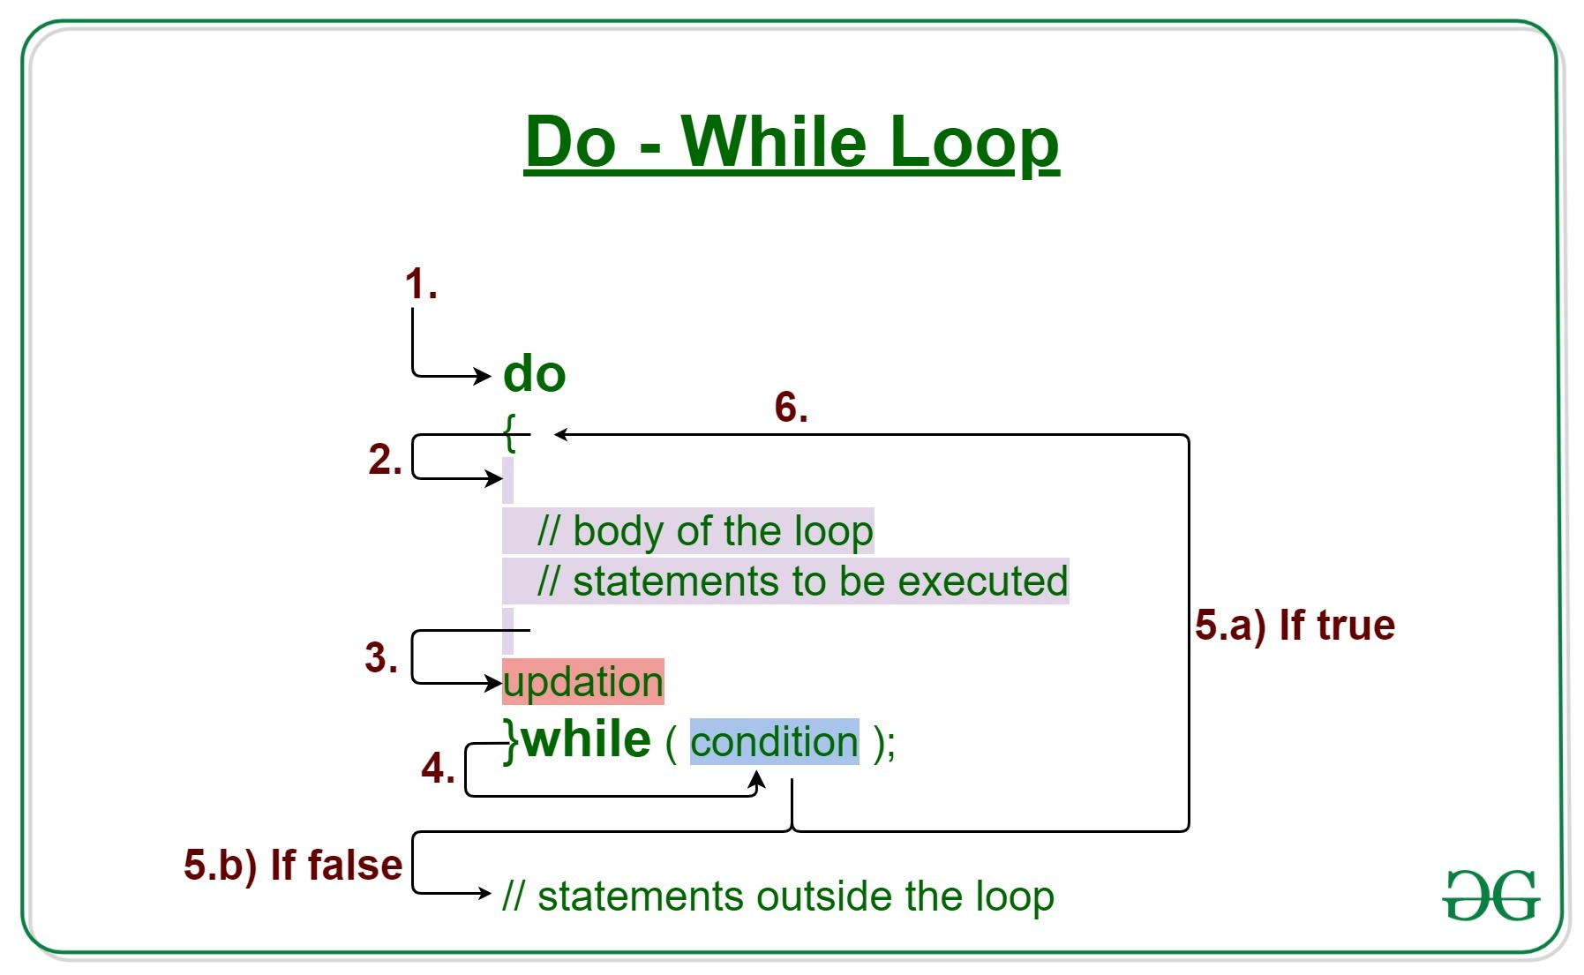
Do While Loop

Slide 19
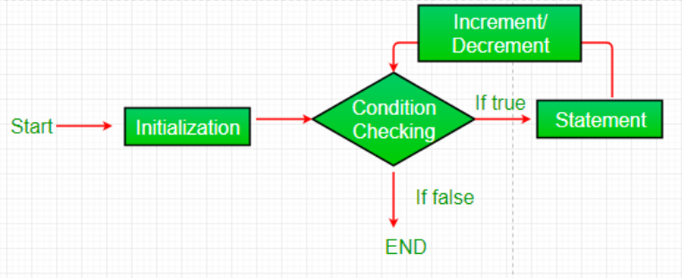
For loop

Slide 20
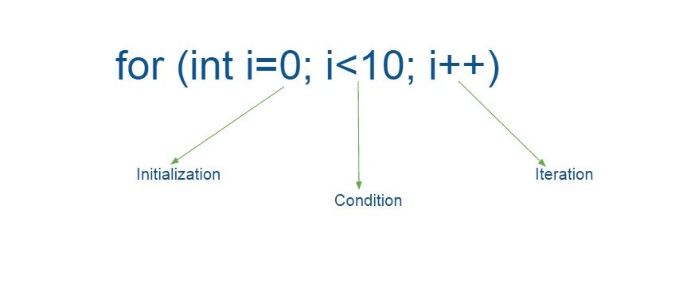
For Loop

Slide 21
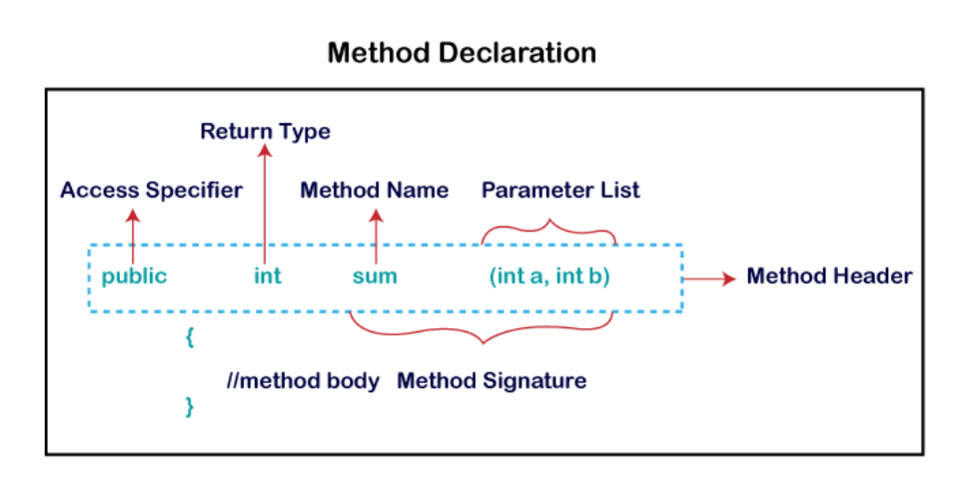
Java methods
A method is a block of code or collection of statements or a set of code grouped together to perform a certain task or operation. It is used to achieve the reusability of code.

Slide 22
Access modifiers
There are four types of Java access modifiers:
Private: The access level of a private modifier is only within the class. It cannot be accessed from outside the class.
Default: The access level of a default modifier is only within the package. It cannot be accessed from outside the package. If you do not specify any access level, it will be the default.
Protected: The access level of a protected modifier is within the package.
Public: The access level of a public modifier is everywhere. It can be accessed from within the class, outside the class, within the package and outside the package.

Slide 23
Return Types in Java
A return statement causes the program control to transfer back to the caller of a method.
Every method in Java is declared with a return type and it is mandatory for all java methods.
A return type may be a primitive type like int, float, double, a reference type or void type(returns nothing).

Slide 24
Exception Handling
An exception normally disrupts the normal flow of the application; that is why we need to handle exceptions.
Exception handling is primarily to maintain the normal flow of the application.
The Exception Handling in Java is one of the powerful mechanism to handle the runtime errors so that the normal flow of the application can be maintained.

Slide 25
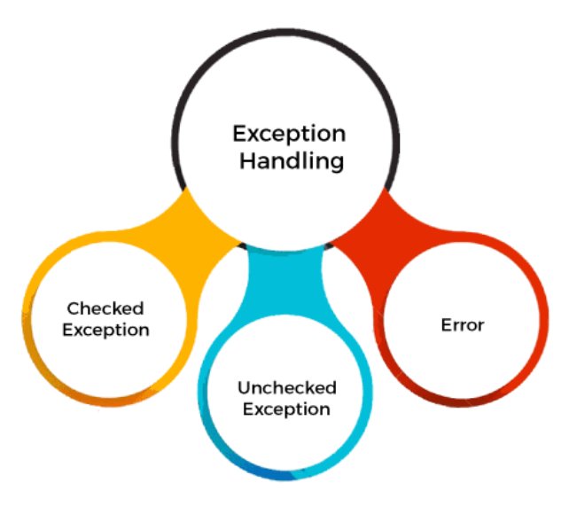
Types of Exceptions

Slide 26
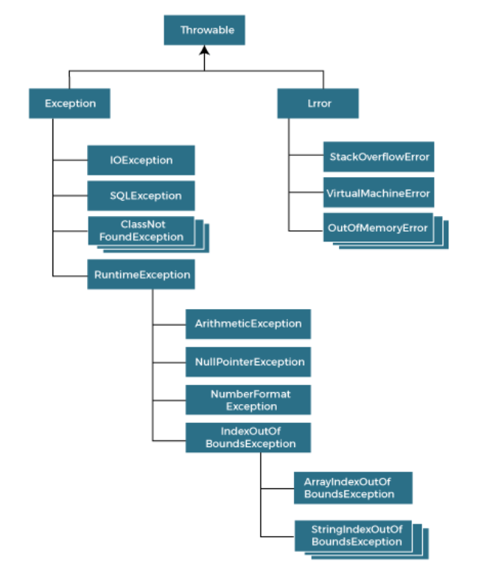
Exception Hierarchy

Slide 27
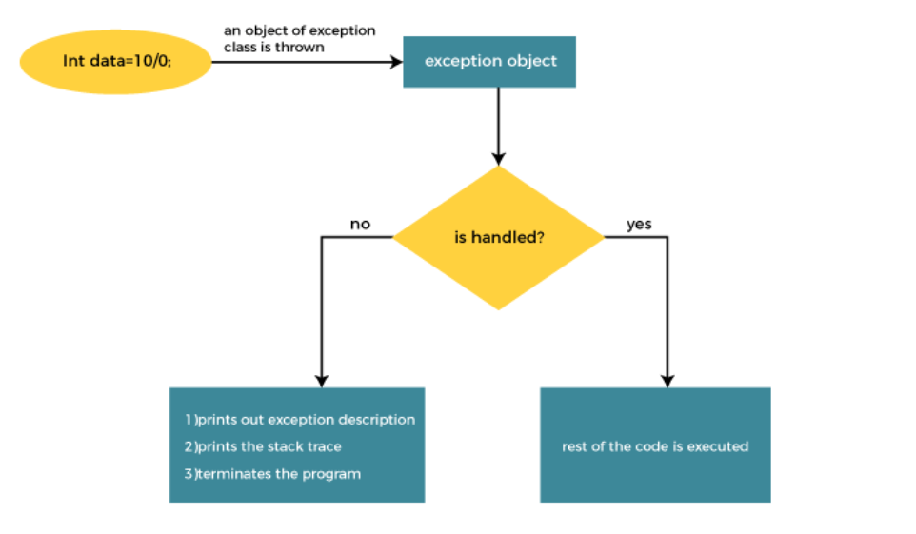
Why Exception Handling?

Slide 28
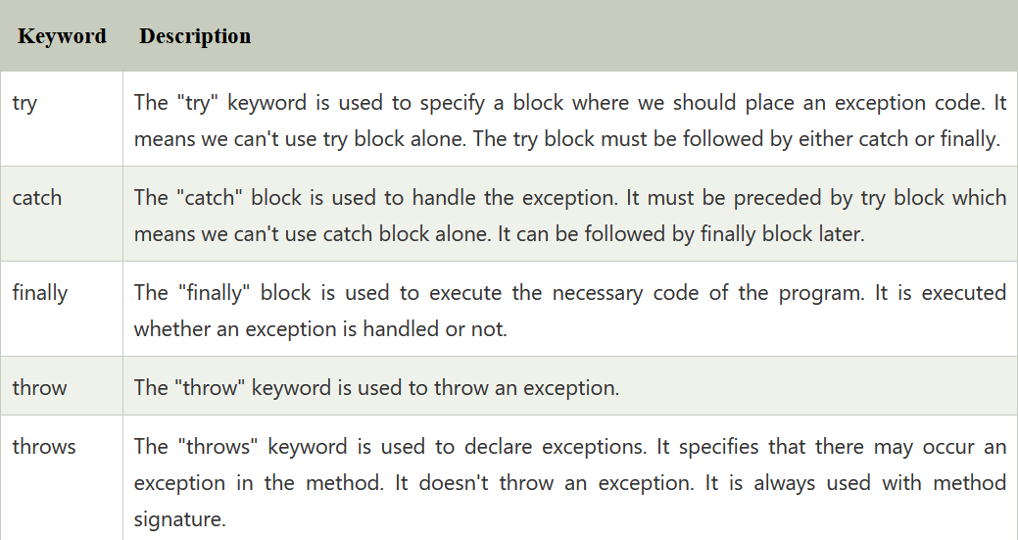
Exception Keywords

Slide 29
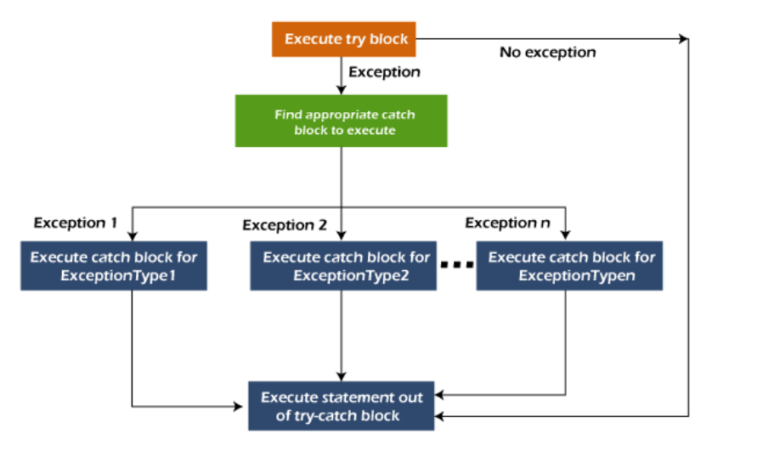
Try Catch Block

Slide 30
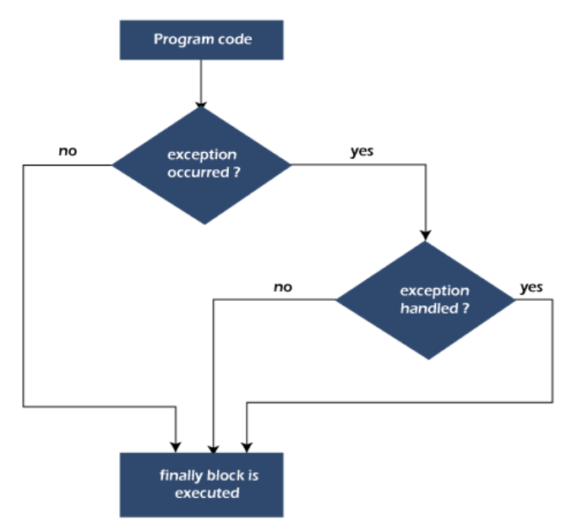
Finally Block
Java finally block is a block used to execute important code such as closing the connection, etc.
Java finally block is always executed whether an exception is handled or not. Therefore, it contains all the necessary statements that need to be printed regardless of the exception occurs or not.
The finally block follows the try-catch block.

Slide 31
Throw vs Throws
The Java throw keyword is used to throw an exception explicitly.
The Java throws keyword is used to declare an exception. It gives an information to the programmer that there may occur an exception.
So, it is better for the programmer to provide the exception handling code so that the normal flow of the program can be maintained.

